Slide 1


Resume Writing Workshop
careers.ucr.edu (951) 827-3631
CONNECT. INSPIRE. EMPOWER.

Slide 2
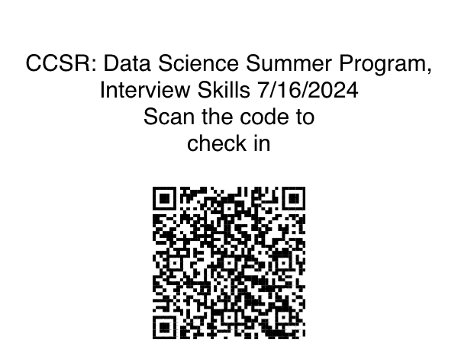

Slide 3



Agenda
Resume Format
Resume Content
Tailoring your resume
Resume Activity
Next Steps

Slide 4






What You'll Learn Today
At the end of this workshop, you will be able to...
The ability to communicate what a resume is and why it is important to your career development
Identify format and content ideas to implement on your own resume
Understand why and how to use a resume to articulate your experiences, strengths, and skills

Slide 5








NACE CAREER READINESS COMPETENCIES
Obtaining requisite competencies that broadly prepare college graduates for a successful transition into the workplace.

Slide 6
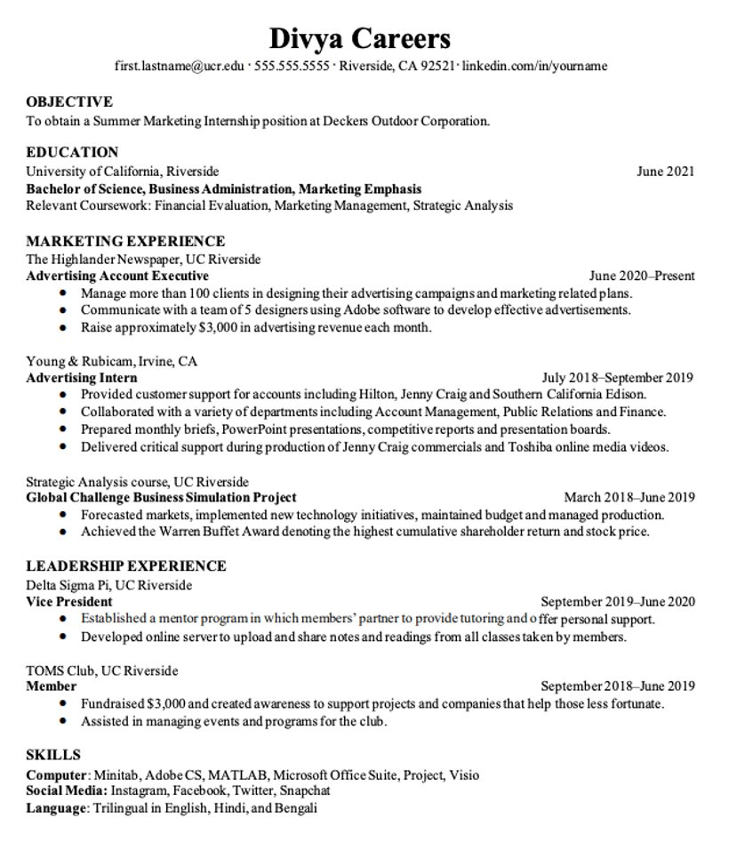
Chronological Format
Presents education and work experience in reverse chronological order
Easy to read
Most used and preferred
Effective and allows to highlight most relevant experiences
Most Recent
Least Recent

Slide 7

1
2
Main Sections on a Resume
3
6
4
Contact Information​
Objective (optional)​
Education​
Experience​
Skills​
Relevant Coursework​
Campus Involvement, Volunteer, Extracurricular Activities*
4
4
5

Slide 8

Components of a Resume

Slide 9
Education
EDUCATION
Bachelor of Arts, Business Administration, Marketing June 20xx
University of California, Riverside
Associate of Arts, University Studies June 20xx
Chaffey College
Tips:
Most recent degree first
Dates on the right-hand side to balance page
Include minors
Only list schools from which you receive a degree
GPA is optional
Relevant courses or study abroad

Slide 10

What counts as experience?
Paid or unpaid
Presentations or public speaking
Service in student organizations
Community services experience
Formal or informal faculty research
Volunteering
Internships
Class projects, labs, major assignments
Senior Thesis/Capstone

Slide 11

Experience Examples/TAR Method
Academic Resource Center, UCR
Peer Mentor September 20xx – June 20xx
Deliver academic support for students encountering academic difficulty to aid in skills and study habits to achieve success in their undergraduate education.
Tutor 1st and 2nd year UCR students in mathematics using broad-based strategies and techniques to promote critical thinking and problem-solving.
Collaborate on a team of 25+ peer mentors to lead group study sessions to help nontraditional students succeed in their courses and their professional development.
Designed and implemented new virtual strategies using Zoom & Slack to onboard new mentors and mentees during COVID-19 which resulted in sustainable curriculum for all incoming new mentors.
What are the tasks, actions & results in this resume description?

Slide 12
Experience Examples/TAR Method
Academic Resource Center, UCR
Peer Mentor September 20xx – June 20xx
Deliver academic support for students encountering academic difficulty to aid in skills and study habits to achieve success in their undergraduate education.
Tutor 1st and 2nd year UCR students in mathematics using broad-based strategies and techniques to promote critical thinking and problem-solving.
Collaborate on a team of 25+ peer mentors to lead group study sessions to help nontraditional students succeed in their courses and their professional development.
Designed and implemented new virtual strategies using Zoom & Slack to onboard new mentors and mentees during COVID-19 which resulted in new sustainable curriculum for all future incoming mentors.

Slide 13
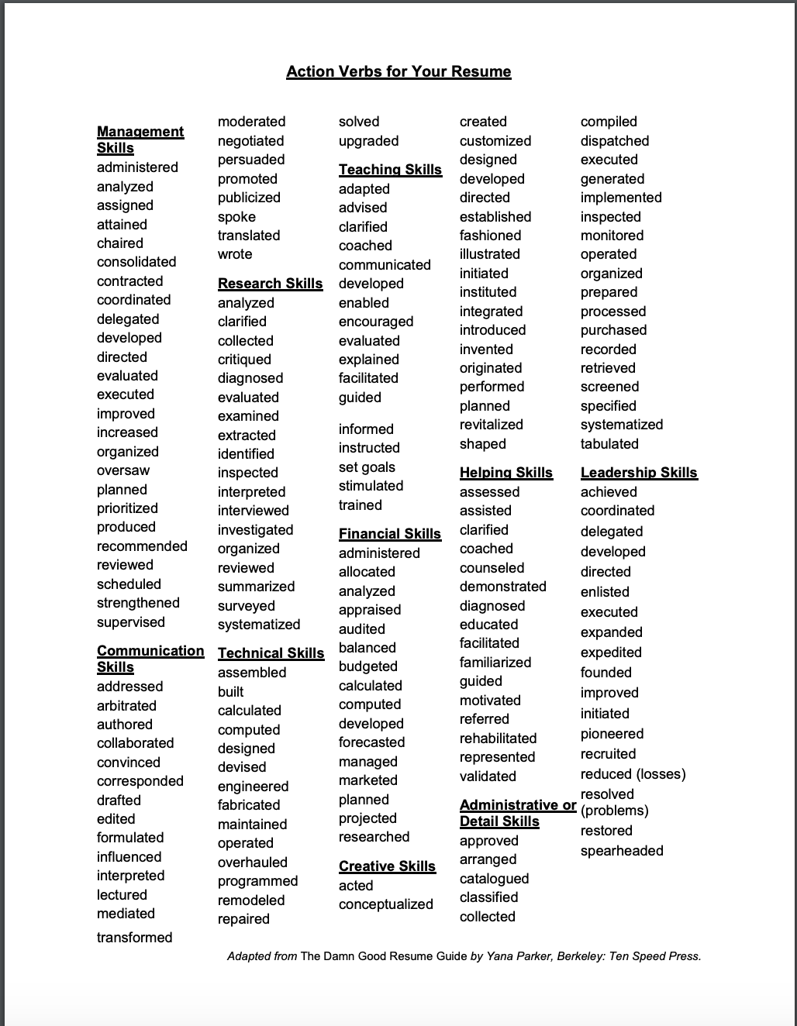
Action Verbs Worksheet
Choose words that will highlight your skills!

Slide 14
Your resume in action
Tailoring your document to a job description
Relevance to the position
Keywords for ATS
Attention to detail
Show them you know the company and its goals
Show that you understand the industry

Slide 15
Your resume in action
Sample job description
Data Science Leadership Development Program (Entry-Level Position with a Science Services Company):
The DSLDP prepares participants for roles of increasing responsibility through a combination of rotational assignments, structured learning, formalized feedback, and mentoring. Program participants will have the opportunity to interact with senior Data Science and IT leaders and participate in various key Data Science initiatives. Program participants will have 2 one-year rotation assignments during the two-year program. As part of the rotational program, candidates may rotate through locations including but not limited to: Massachusetts, Pennsylvania, California, etc. Geographic flexibility is required both during and upon completion of the program.
Qualifications:
Students completing a Bachelor’s degree; preferred majors: Mathematics, Data Science, Computer Science, Computational and Data Science & Engineering
GPA of 3.2 or greater
Strong desire and motivation to develop a career as a future leader in Data Science
Related work or internship experience strongly desired
Ability to manage, plan, and prioritize projects
Experience in data collection & analysis
Demonstrated leadership aptitude, learning agility, and adaptability
Understanding of existing & emerging technologies

Slide 16
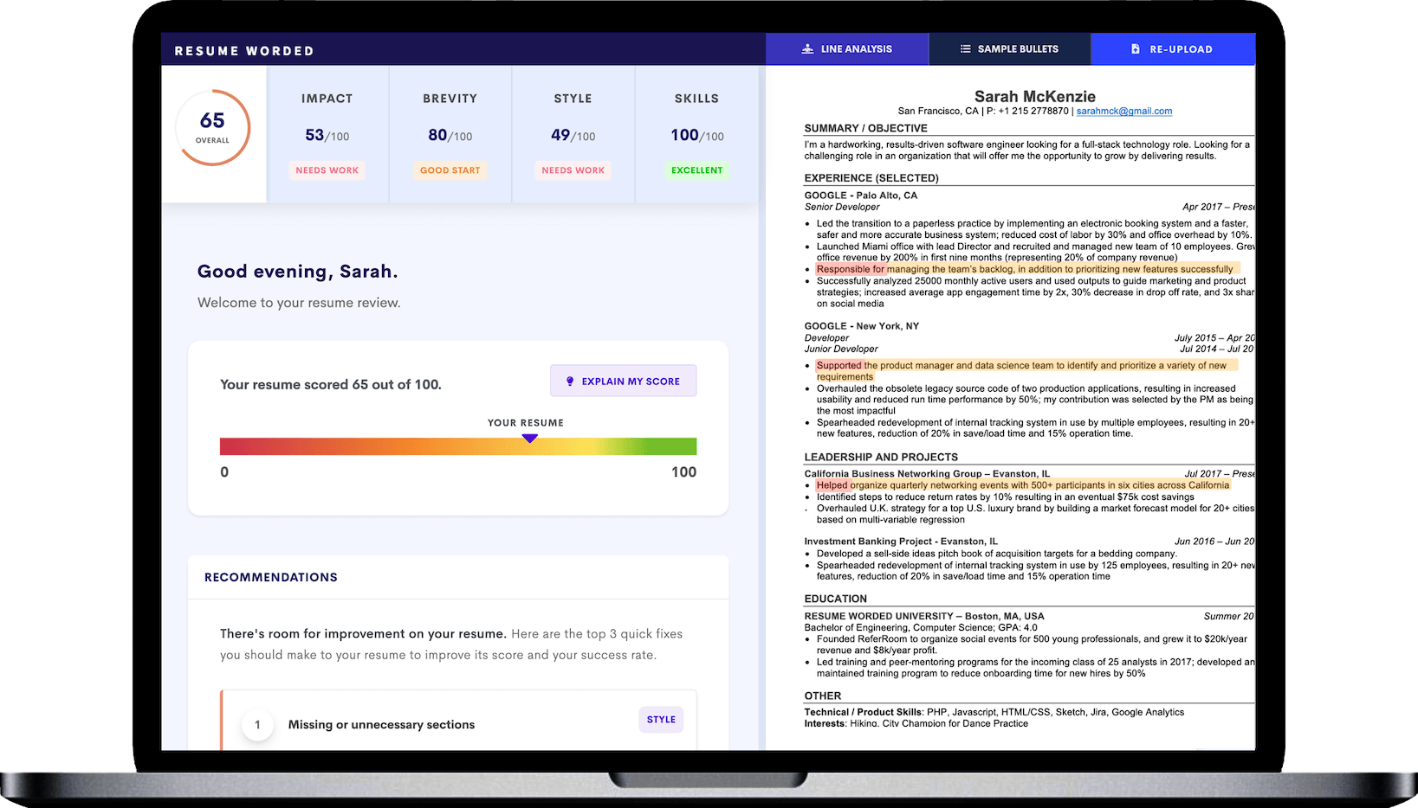
Applicant Tracking System (ATS)
What is it?
Software for recruiters and employers to track candidates throughout the recruiting and hiring process. This software can come equipped with capabilities ranging from simple database functionality to a full-service suite of tools that makes it easy for businesses of any size to filter, manage, and analyze candidates.
"As of 2019, 99% of the Fortune 500 companies used an ATS in their hiring process.¹ These companies already have the brand recognition and resources to compete for top talent; an ATS can level the playing field by creating better, quicker access to candidates."
Jobscan 2022 Report
Sample ATS Checking on Resume Worded
Notes:
Source:
Hu, James. “Report: 99% of Fortune 500 Companies Use Applicant Tracking Systems.” Jobscan, 10 Oct. 2022, www.jobscan.co/blog/99-percent-fortune-500-ats/.

Slide 17
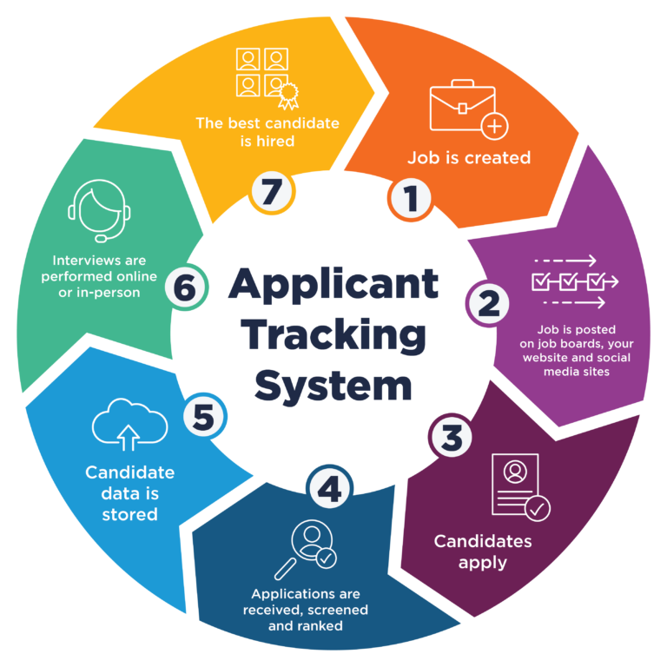
Applicant Tracking (ATS) Importance
Why does this matter?
These tracking systems will likely be the first impression of your resume. This highlights the importance of tailoring your resume and incorporating key: skills, action verbs, and language in your resume to be industry specific to a position.
Weaving in recurring preferred qualifications/skills
Tailor your current skills and experiences to match
the job description

Slide 18

Resume Checklist
One page maximum
10-second glance: most relevant first
Tailor your resume to the position
Use industry language to describe experience
All relevant experience, paid or unpaid
High school Diploma (remove this)
Avoid personal pronouns (I, me, my)
Use appropriate verb tenses
Error free (both spelling and grammar)
Upload in Word & PDF if you can

Slide 19

What else do you need?
References Page​
Develop your LinkedIn​
Resume review

